Slide 1
Development of website for a Training Organization
Module Project
Module: Front End Web Development
Course: ITSF - Front End Web Development
Start Date :
End Date :
Submission Date :
Learner Name : Viddy Virstandi Paramanayaka Andanawari Purnama
Enrollment ID :
Presentation Date :

Slide 2
Contents
Document History
Version Number | Effective Date of release | Summary of Included Changes | Author
1 | 4th March 2016 | First Edition | Satya CVS
2 | 7th April 2016 | Changed for Module 2 | Shrinivas K R
3 | 2nd April 2018 | Changed for RQF | Shrinivas K R

Slide 3
Contents
Contents
1. Project Definition
2. Development Tools
3. Information Architecture
4. Storyboard
5. Menus
6. Business Process
7. Lead Generation Form Design
8. HTML Catalog
9. HTML Pages
10. CSS Classes
11. Lead Generation Form
12. Pages with Styles
13. User Interface Effectiveness
14 Proposed Changes to User Interface
15. Project Deliverables
16. Project Environment
17. Website Review & Improvements
18. Project Milestones & Tasks
19. Milestone Feedback & Action Taken
20. Project Results
21. Proposed Improvements

Slide 4
1. Project Definition
Project Objective
  To make it easier for users to register for learning HTML, .Net, Java, and Microsoft Office
Proposed Solution
  By making a simple and simple web so that users can easily register

Slide 5




2. Development Tools

Slide 6
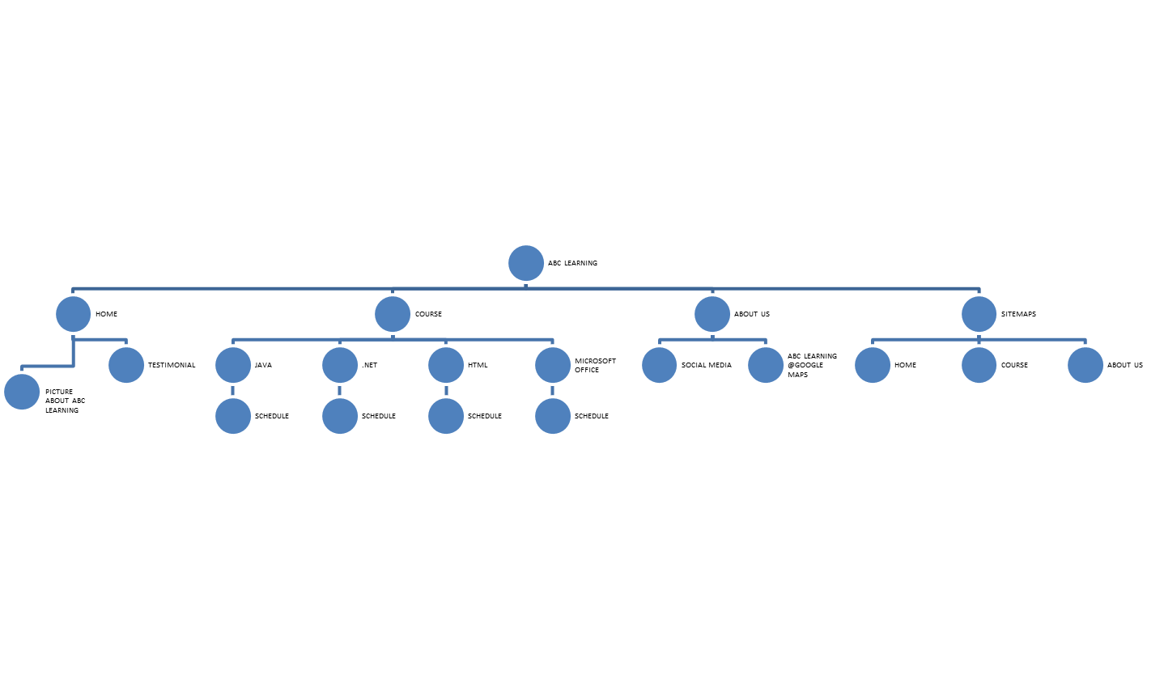
3. Information Architecture
Information Architecture

Slide 7


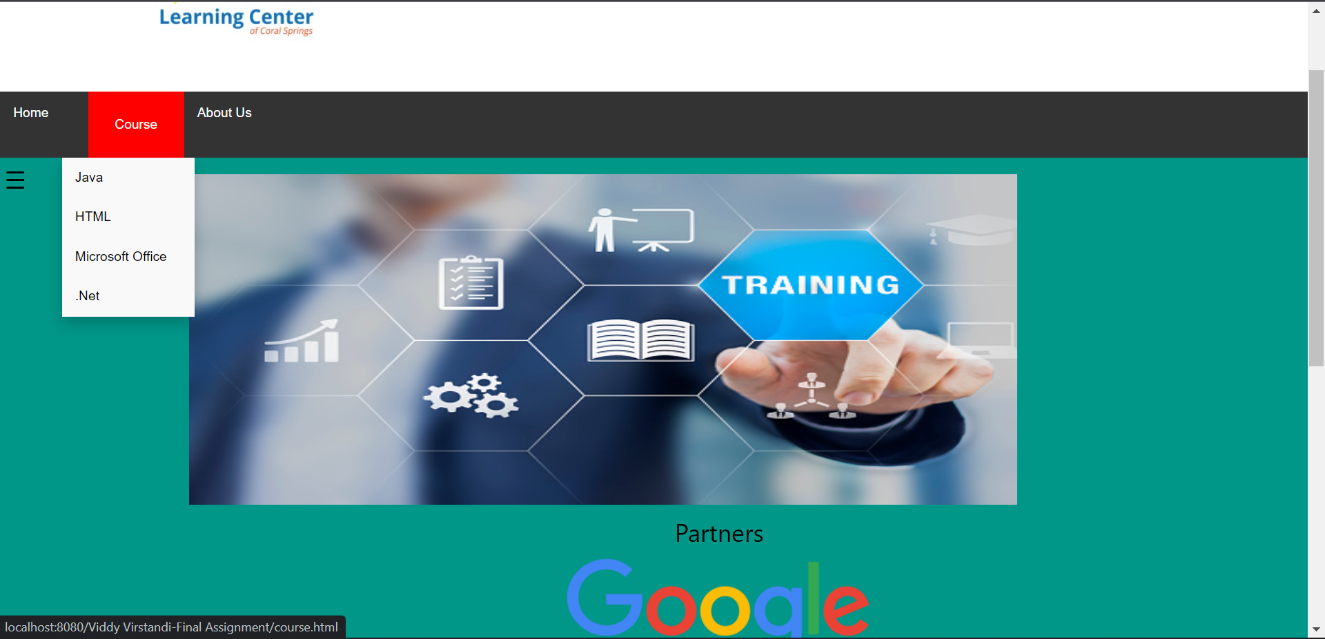
4. Storyboard
Storyboard

Slide 8
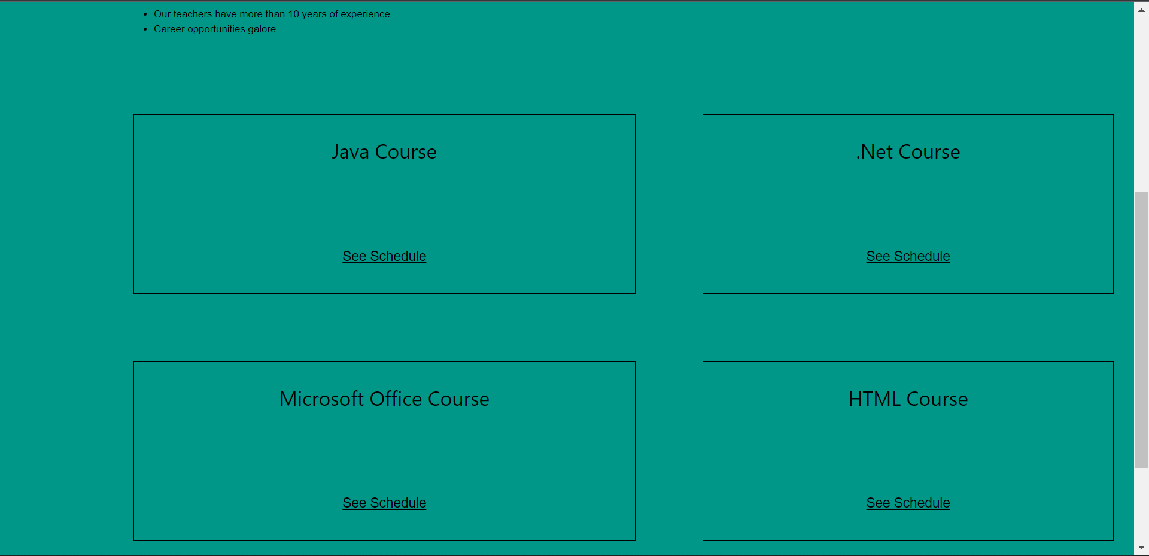
4. Storyboard
Storyboard

Slide 9
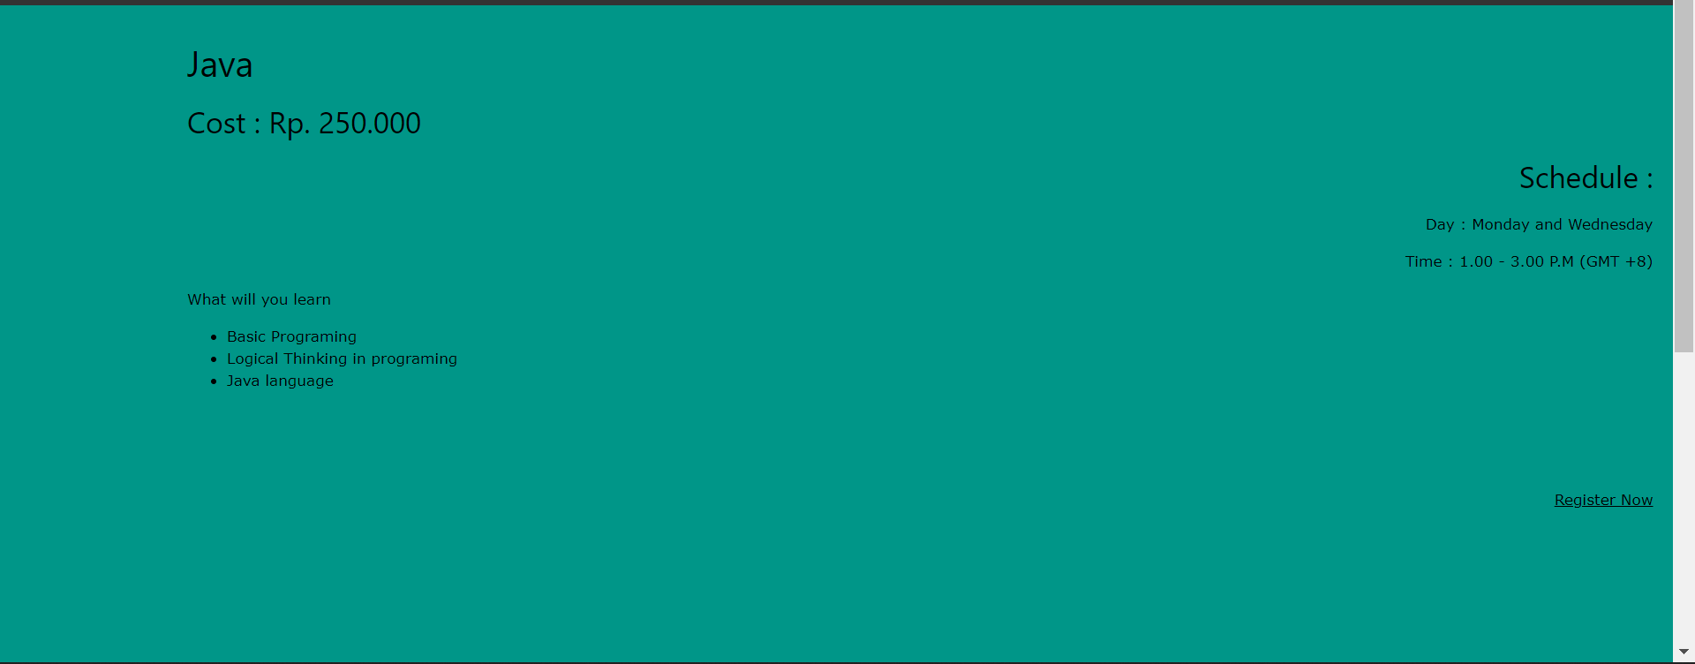
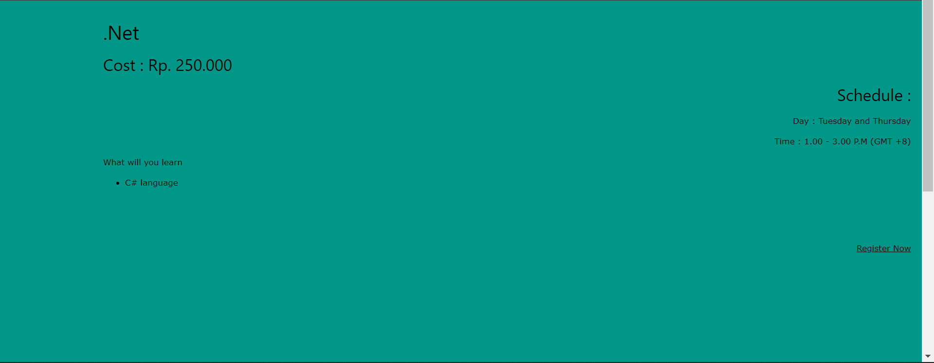
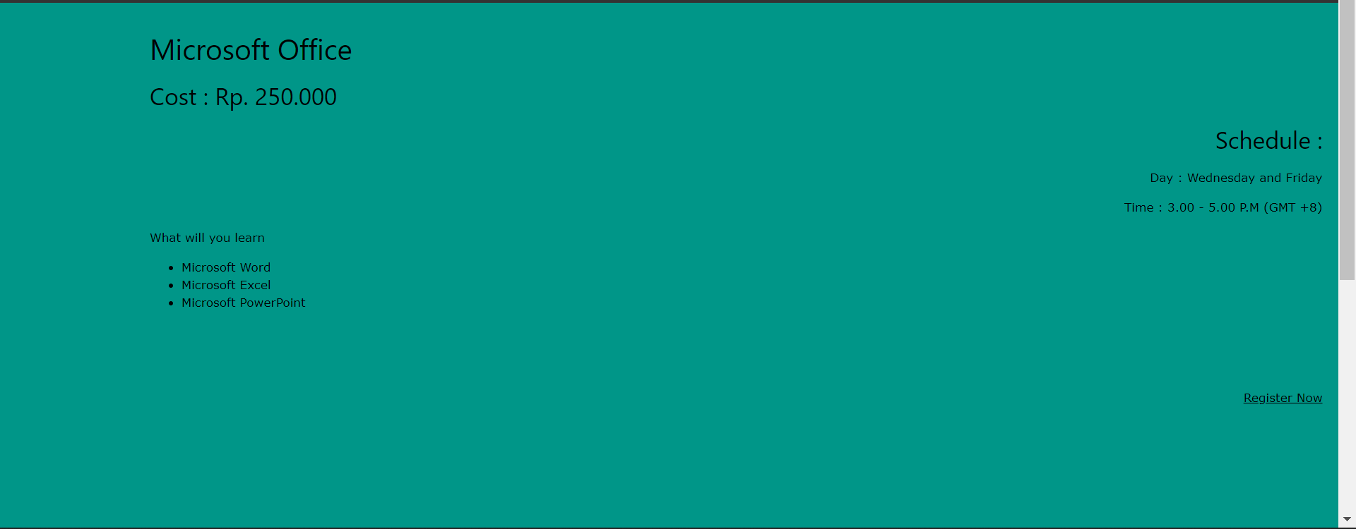
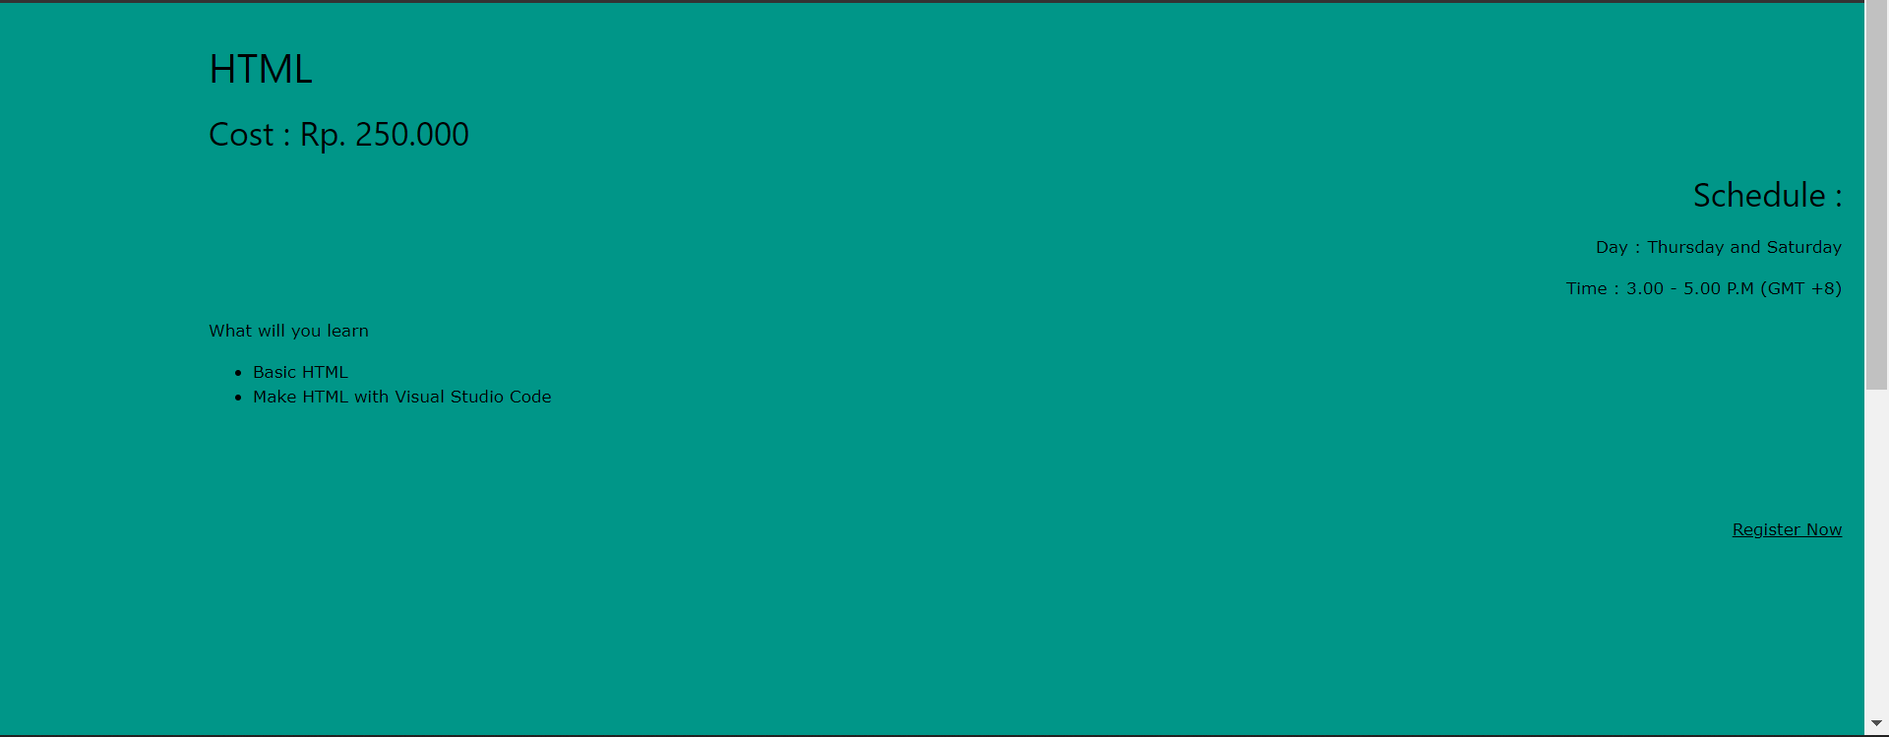
4. Storyboard
Storyboard

Slide 10
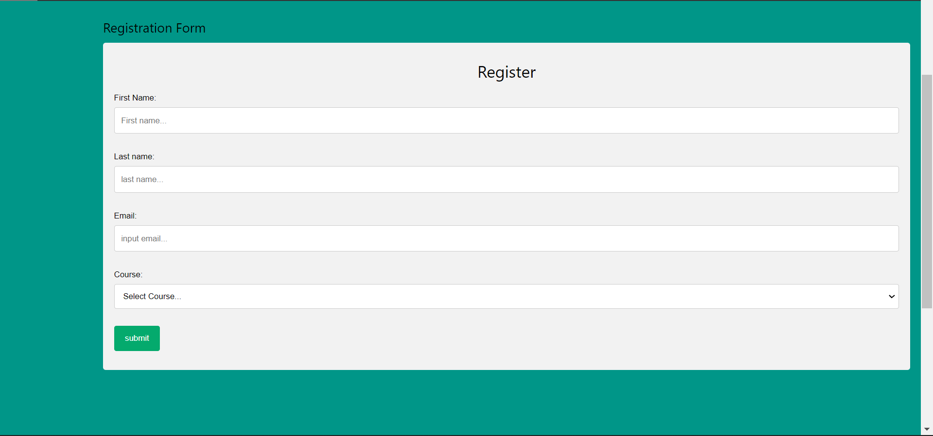
4. Storyboard
Storyboard

Slide 11
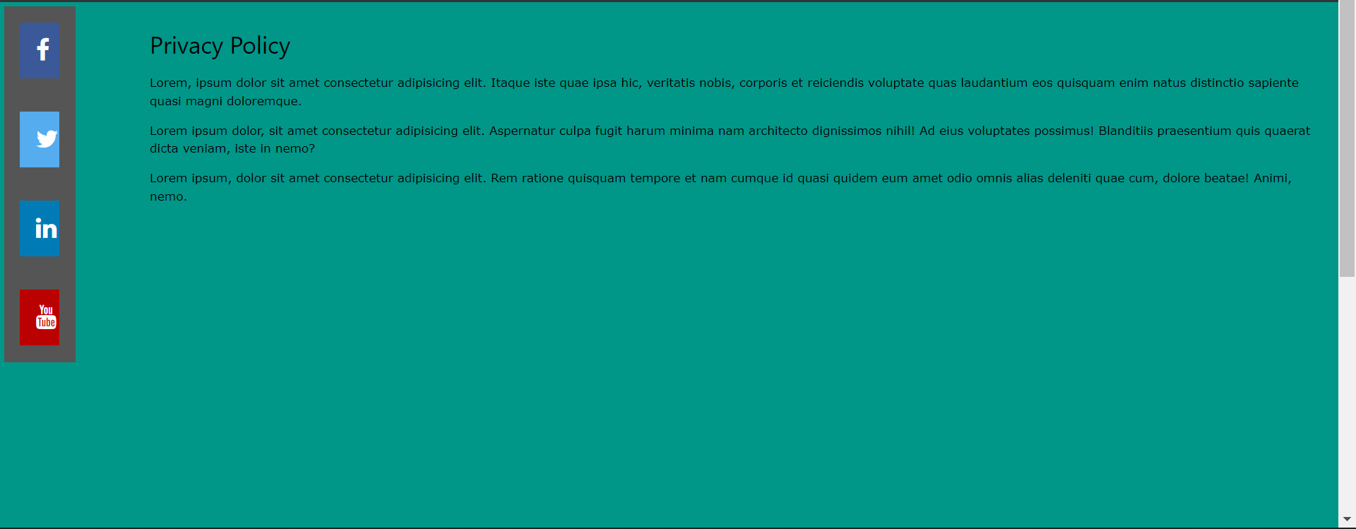
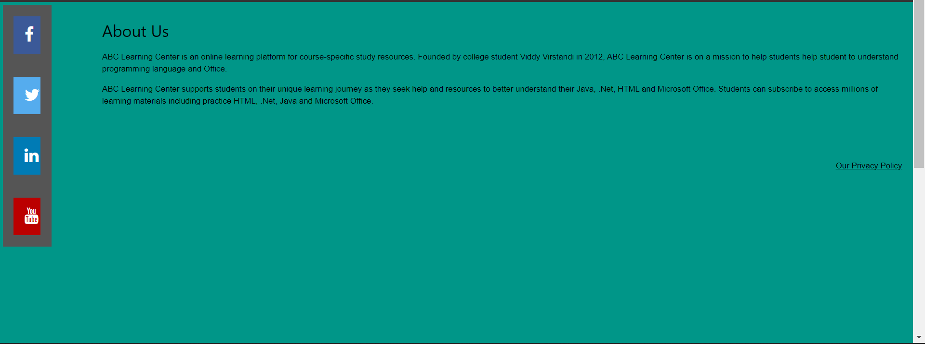
4. Storyboard
Storyboard

Slide 12
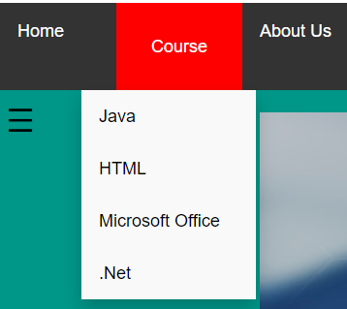
5. Menus
Menus
Dropdown Course
About
ABC Learning Center

Slide 13
6. Business Process
USER
ABC Website
Add data
Edit data
Choose Course
Remove data
Fill Registration Form
ADMIN
Store the data to local storage

Slide 14
7. Lead Generation Form Design

Slide 15
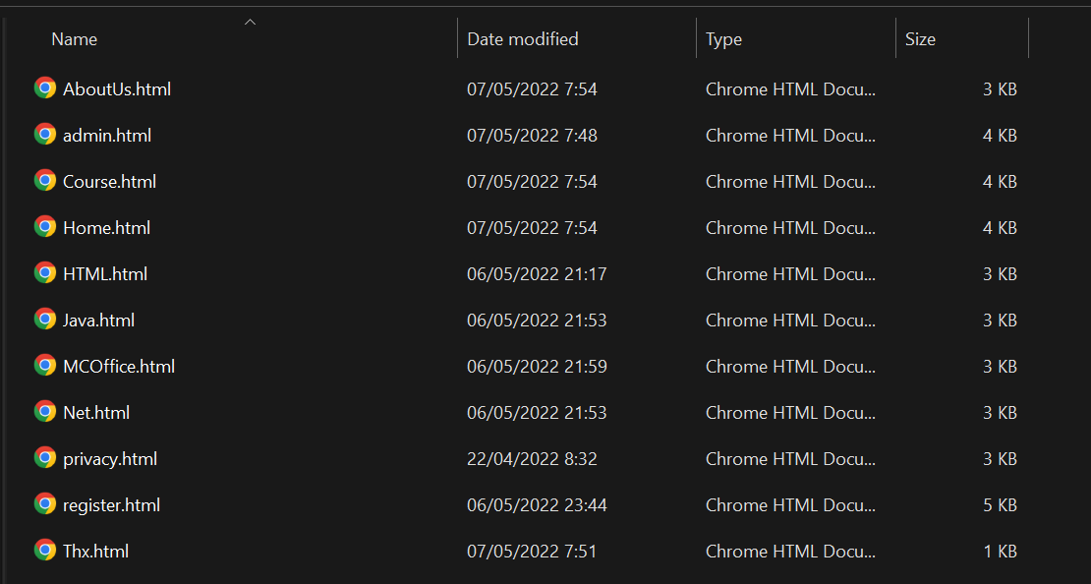
8. HTML Catalog
HTMLadmin | INFO
Home.html | Home page
Course.html | Course Page included all courses
Html.html | Html Courses, Schedule, and course cost
Java.html | Java Courses, Schedule, and course cost
Net.html | .Net Courses, Schedule, and course cost
MCOffice.html | Microsoft Office Courses, Schedule, and course cost
register.html | Registration Form
Thx.html | Thank You Feedback
AboutUs.html | About ABC Learning Center
privacy.html | ABC Learning Center privacy policy
admin.html | Add, edit, remove data for admin only

Slide 16
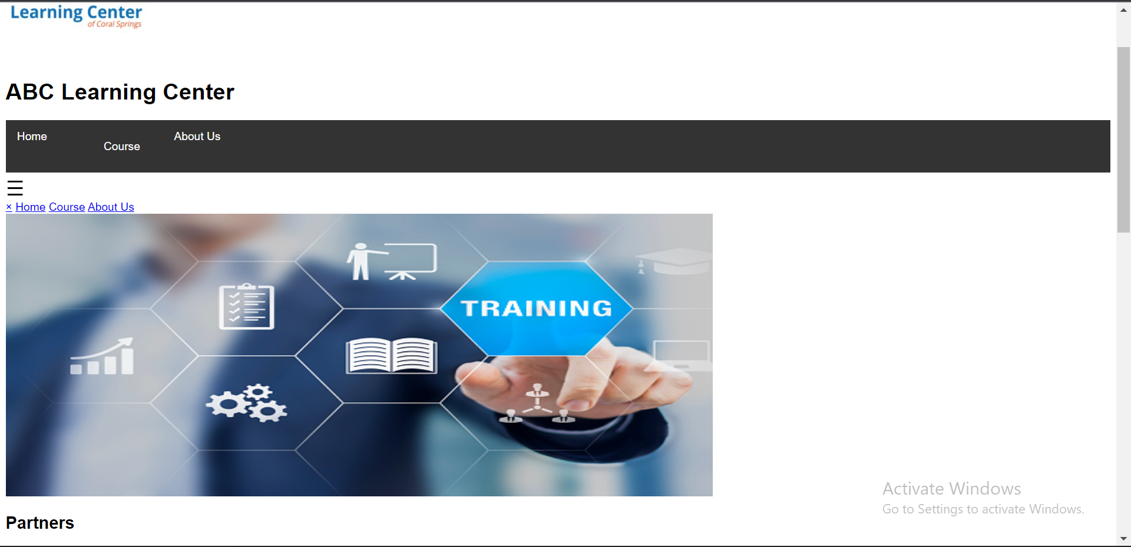
9. HTML Pages
HTML Pages
WITH CSS
WITHOUT CSS

Slide 17
10. CSS Classes
CSS Classes
S. No. | Selector | Style to be Created
1 | header | background-color: rgb(180, 75, 212); padding: 30px; text-align: center; font-size: 35px; color: white;
2 | nav | float: left; width: 10%; height: 1200px; background: #009688; padding: 5px;
3 | .sidenav | height: 100%; width: 0; position: fixed; z-index: 1; top: 0; left: 0; background-color: #111; overflow-x: hidden; transition: 0.5s; padding-top: 60px;

Slide 18
11. Lead Generation Form
Lead Generation Form

Slide 19
12. Pages with Styles
Pages with Styles

Slide 20
13. User Interface Effectiveness
Effectiveness Metrics
The user can fill the registration form under 4 minutes
The data entered by the user is directly stored into the local storage web ABC Learning Center

Slide 21
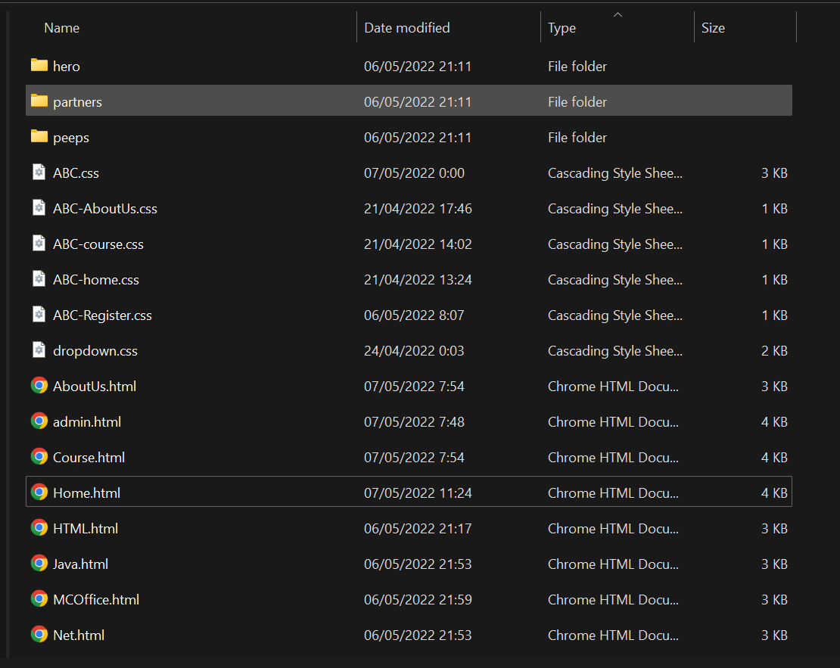
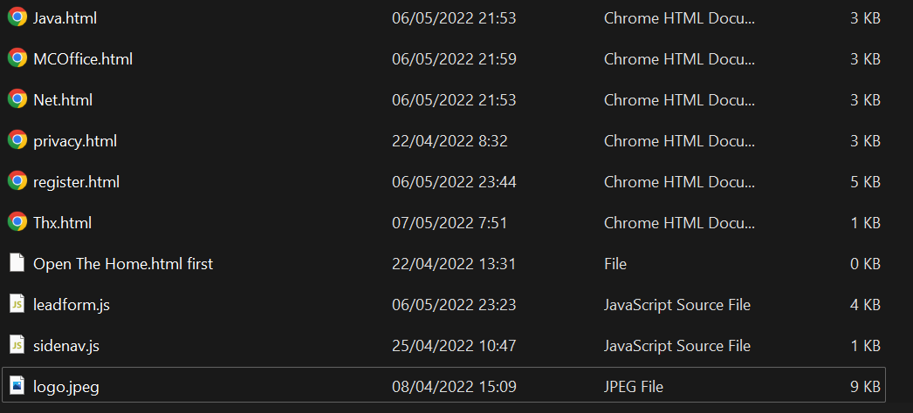
15. Project Deliverables
Project Deliverables
  HTML Pages
  CSS files
  Project Report
  Project Presentation
  Source Code
List of Evidences

Slide 22
16. Project Environment
Technical Environment and Tools Used
  Windows 11 Home
  Visual Studio Code
  Apache Web Server
  Programming Languages: HTML, CSS, JavaScript
  JavaScript libraries: jQuery & jQuery UI
  Google Chrome
List of references
  W3schools.com
  My friend

Slide 23
17. Website Review & Improvements
should add a carousel to make it more interesting
should be given a lot of css to make it look interesting

Slide 24
20. Project Results (1/2)
Screen Shots of Evidences

Slide 25
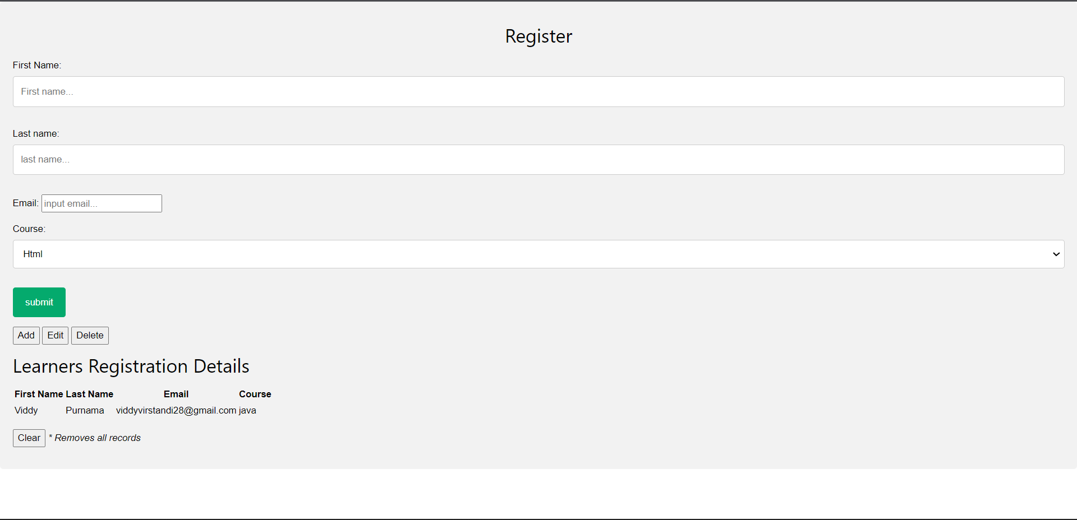
20. Project Results (2/2)

Slide 26
21. Proposed Improvements
List of Improvements
  Increase the use of css in the ABC Learning Center web

